Slide 1
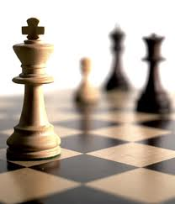


人工智能
罗平 luop@ict.ac.cn

Slide 2

Knowledge 4

Slide 3
First-Order Logic: Deduction

Slide 4
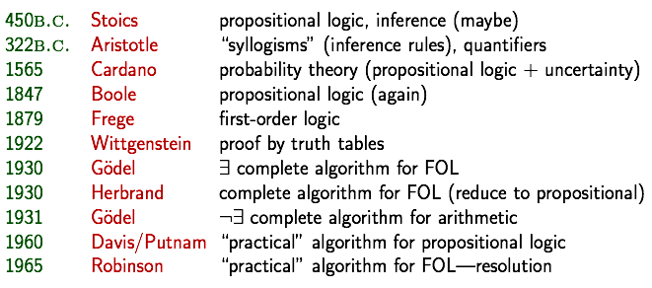
A brief history of reasoning

Slide 5
First-Order Logic: Deduction
Propositionalization

Slide 6
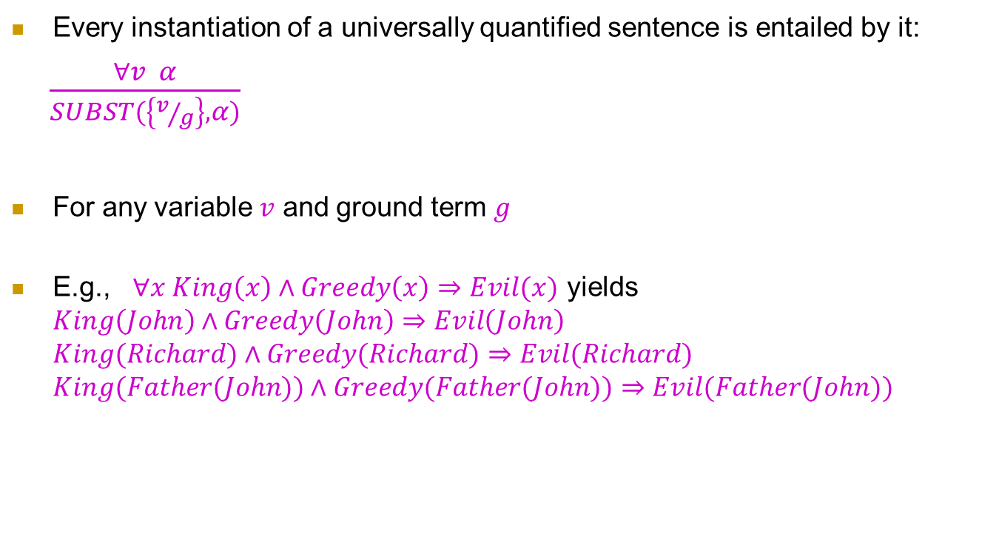

Universal Instantiation (UI)
Every instantiation of a universally quantified sentence is entailed by it:
$\frac{∀v α}{SUBST(\left\{v/g\right\},α)}$
For any variable $v$ and ground term $g$
E.g., $∀x King\left(x\right)∧Greedy\left(x\right)⇒Evil(x)$ yields $King\left(John\right)∧Greedy\left(John\right)⇒Evil\left(John\right)$ $King(Richard)∧Greedy(Richard)⇒Evil(Richard)$ $King(Father(John))∧Greedy(Father(John))⇒Evil(Father(John))$

Slide 7
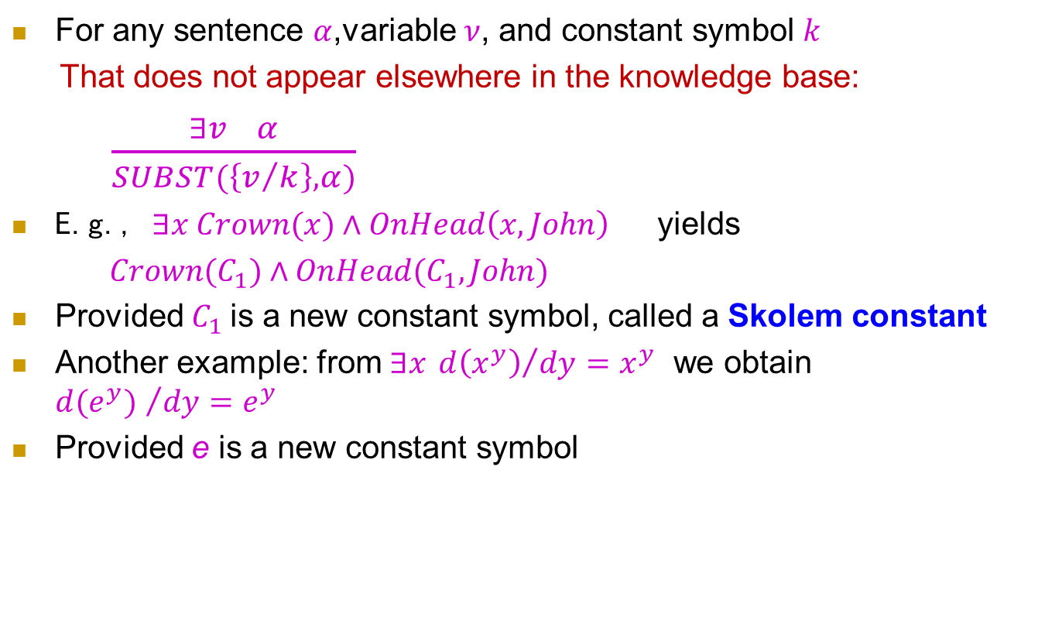

Existential Instantiation (EI)
For any sentence $α$,variable $ν$, and constant symbol $k$
That does not appear elsewhere in the knowledge base:
$\frac{∃v α}{SUBST(\left\{v/k\right\},α)}$
E.g., $∃x Crown(x)∧OnHead\left(x,John\right)$ yields
$Crown(C_{1})∧OnHead(C_{1},John)$
Provided $C_{1}$is a new constant symbol, called a Skolem constant
Another example: from $∃x {d\left(x^{y}\right)}/{dy}=x^{y}$ we obtain ${d(e^{y}) }/{dy=e^{y}}$
Provided e is a new constant symbol

Slide 8
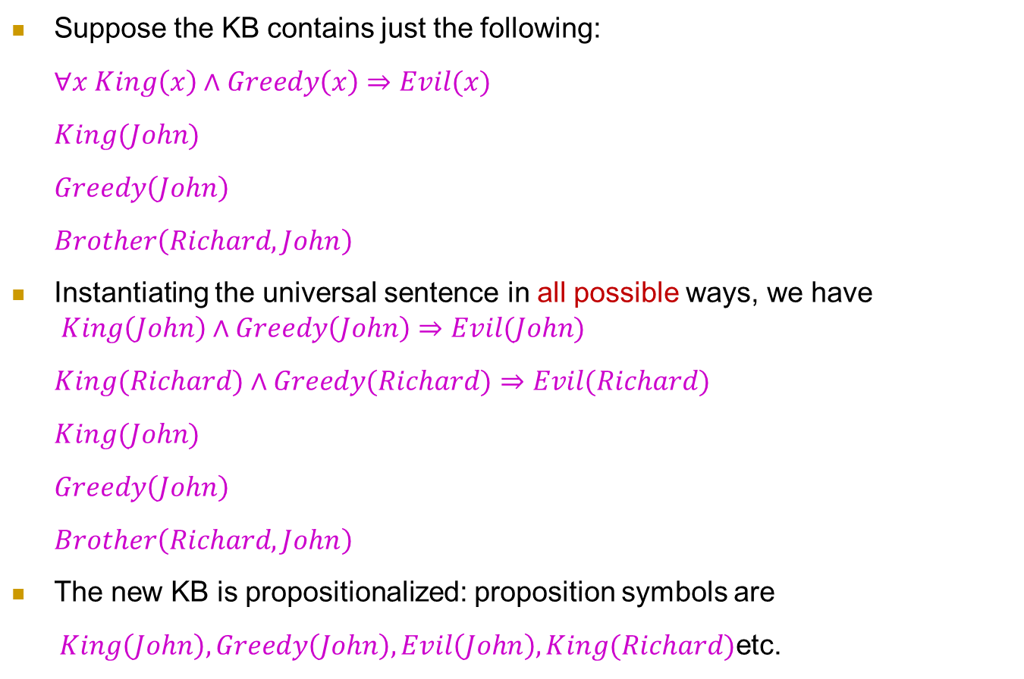

Reduction to propositional inference
Suppose the KB contains just the following:
$∀x King\left(x\right)∧Greedy\left(x\right)⇒Evil(x)$
$King(John)$
$Greedy\left(John\right)$
$Brother\left(Richard,John\right)$
Instantiating the universal sentence in all possible ways, we have $King\left(John\right)∧Greedy\left(John\right)⇒Evil(John)$
$King(Richard)∧Greedy(Richard)⇒Evil(Richard)$
$King(John)$
$Greedy\left(John\right)$
$Brother\left(Richard,John\right)$
The new KB is propositionalized: proposition symbols are
$King\left(John\right),Greedy\left(John\right),Evil\left(John\right),King(Richard)$etc.

Slide 9
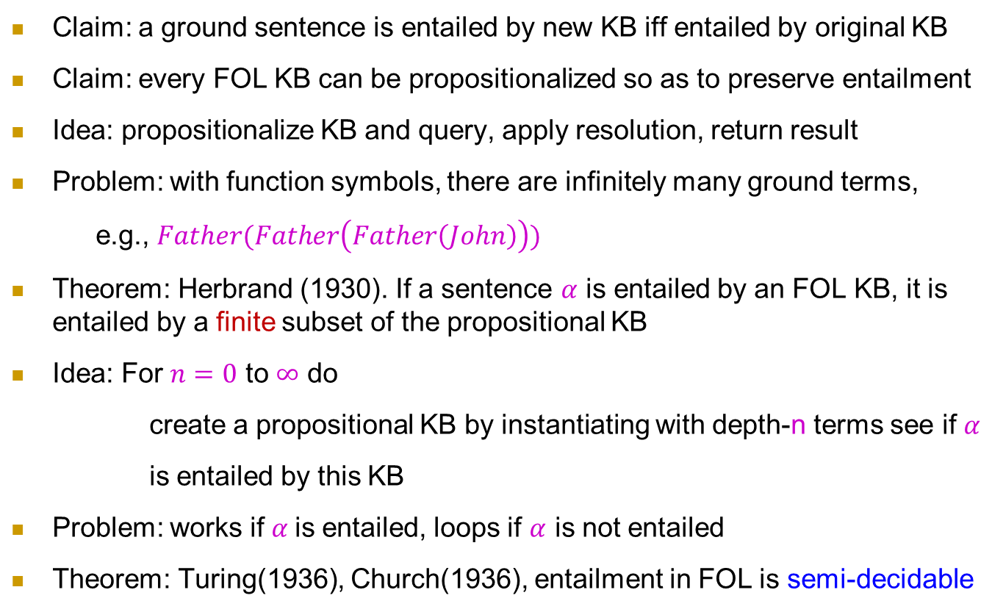
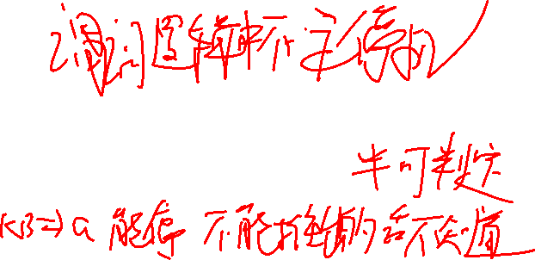
Reduction to propositional inference
Inferentially equivalent
Claim: a ground sentence is entailed by new KB iff entailed by original KB
Claim: every FOL KB can be propositionalized so as to preserve entailment
Idea: propositionalize KB and query, apply resolution, return result
Problem: with function symbols, there are infinitely many ground terms,
e.g., $Father(Father\left(Father\left(John\right)\right))$
Theorem: Herbrand (1930). If a sentence $α$ is entailed by an FOL KB, it is entailed by a finite subset of the propositional KB
Idea: For $n=0$ to $∞$ do
create a propositional KB by instantiating with depth-n terms see if $α$
is entailed by this KB
Problem: works if $α$is entailed, loops if $α$ is not entailed
Theorem: Turing(1936), Church(1936), entailment in FOL is semi-decidable

Slide 10
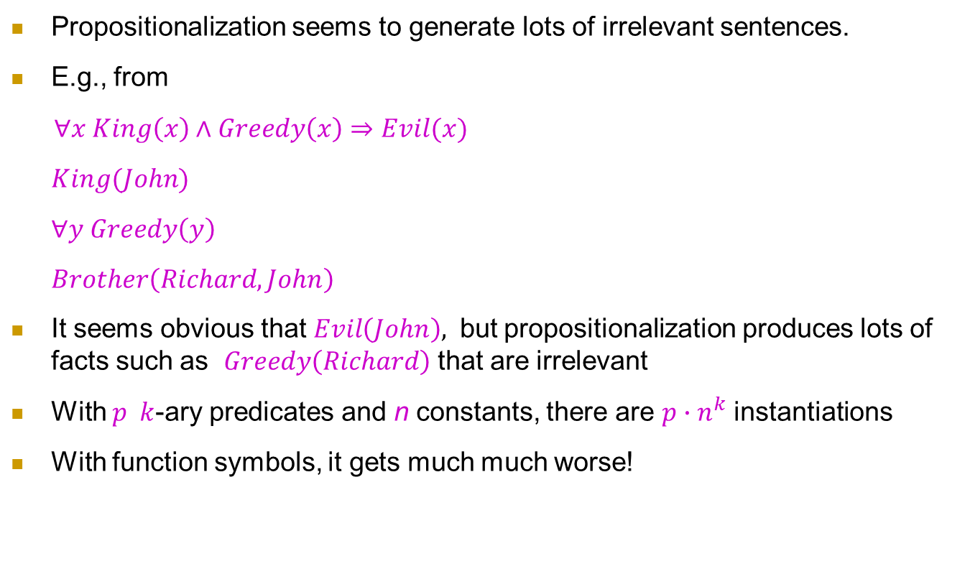
Problems with Propositionalization
Propositionalization seems to generate lots of irrelevant sentences.
E.g., from
$∀x King\left(x\right)∧Greedy\left(x\right)⇒Evil(x)$
$King(John)$
$∀y Greedy\left(y\right)$
$Brother\left(Richard,John\right)$
It seems obvious that $Evil\left(John\right),$ but propositionalization produces lots of facts such as $Greedy\left(Richard\right)$ that are irrelevant
With $p k$-ary predicates and n constants, there are $p∙n^{k}$ instantiations
With function symbols, it gets much much worse!

Slide 11
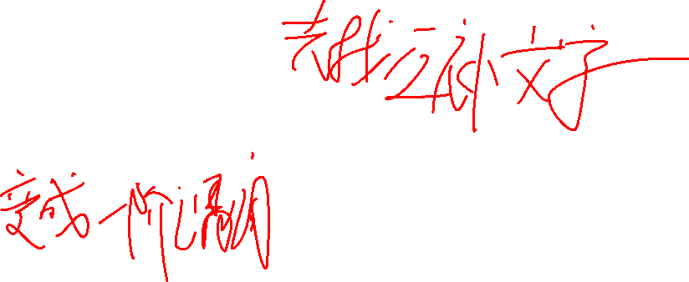
First-Order Logic: Inference
Resolution in FOL

Slide 12
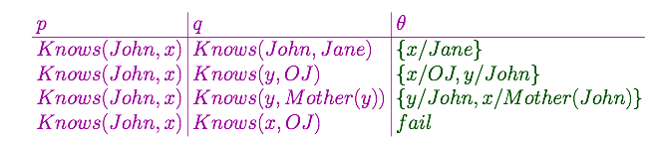

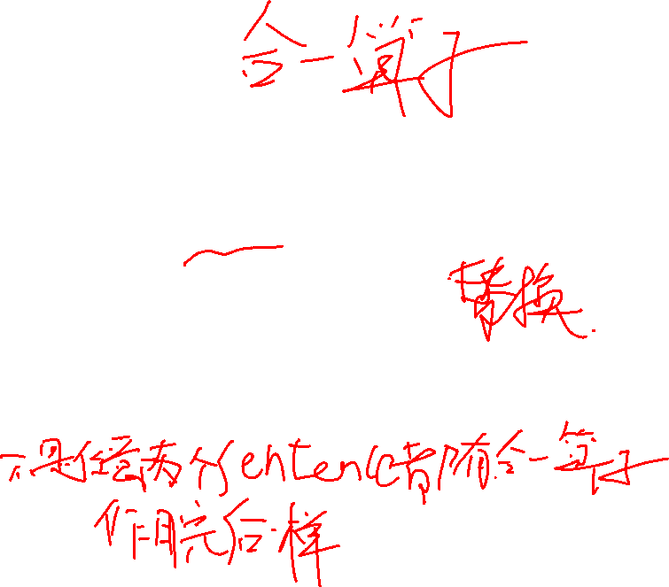
Unification
We can get the inference immediately if we can find a substitution $θ$ such that $King(x)$ and $Greedy(x)$ match $King(John)$ and $Greedy(y)$
$θ=\{x/{John},y/{John\}}$ works
$UNIFY\left(α,β\right)=θ$ if $αθ=βθ$
$$\text{Standardizing} \text{apart} \text{eliminates} \text{overlap} \text{of} \text{variables}\text{, }\text{e}\text{.}\text{g}\text{., }K\text{nows} \left(z_{17},OJ\right)$$

Slide 13



Resolution: brief summary
Full first-order version
Where $UNIFY\left(l_{i},¬m_{j}\right)=θ$
For example,
With $θ=\{x/{Ken}\}$
Apply resolution steps to CNF(KB$∧¬α$); complete for FOL
$$\frac{l_{1}∨…∨l_{k}, m_{1}∨…∨m_{n}}{(l_{1}∨…∨l_{i−1}∨l_{i+1}∨…∨l_{k}∨m_{1}∨…∨m_{j−1}∨m_{j+1}∨…∨m_{n}}$$
$$\frac{¬Rich\left(x\right)∨Unhappy\left(x\right) , Rich\left(Ken\right)}{Unhappy(Ken) }$$

Slide 14
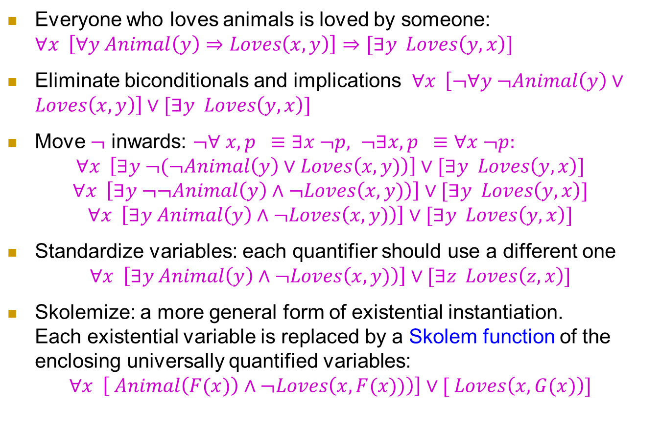
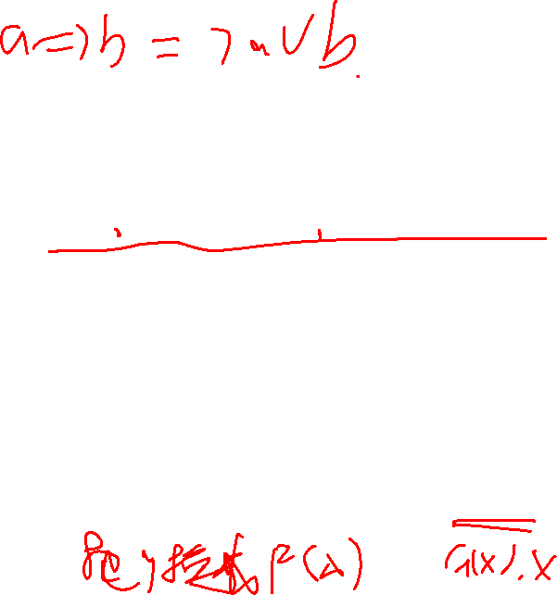
Conversion to CNF
Everyone who loves animals is loved by someone: $∀x \left[∀y Animal\left(y\right)⇒Loves\left(x,y\right)\right]⇒[∃y Loves\left(y,x\right)]$
Eliminate biconditionals and implications $∀x \left[¬∀y ¬Animal\left(y\right)∨Loves\left(x,y\right)\right]∨[∃y Loves\left(y,x\right)]$
Move $¬$ inwards: $¬∀ x, p ≡∃x ¬p, ¬∃x,p ≡∀x ¬p:$
$$∀x \left[∃y ¬(¬Animal\left(y\right)∨Loves\left(x,y)\right)\right]∨[∃y Loves\left(y,x\right)]$$
$$∀x \left[∃y ¬¬Animal\left(y\right)∧¬Loves\left(x,y)\right)\right]∨[∃y Loves\left(y,x\right)]$$
$$∀x \left[∃y Animal\left(y\right)∧¬Loves\left(x,y)\right)\right]∨[∃y Loves\left(y,x\right)]$$
Standardize variables: each quantifier should use a different one
$$∀x \left[∃y Animal\left(y\right)∧¬Loves\left(x,y)\right)\right]∨[∃z Loves\left(z,x\right)]$$
Skolemize: a more general form of existential instantiation. Each existential variable is replaced by a Skolem function of the enclosing universally quantified variables:
$$∀x \left[ Animal\left(F(x)\right)∧¬Loves\left(x,F(x))\right)\right]∨[ Loves\left(x,G(x)\right)]$$

Slide 15


Conversion to CNF
Drop universal quantifiers:
$$\left[ Animal\left(F(x)\right)∧¬Loves\left(x,F(x))\right)\right]∨[ Loves\left(G(x),x\right)]$$
Distribute $∧$ over $∨$ :
$$\left[ Animal\left(F(x)\right)∧¬Loves\left(G(x),x)\right)\right]∨[¬Loves\left(x,F(x)\right)∨Loves\left(G(x),x\right)]$$

Slide 16
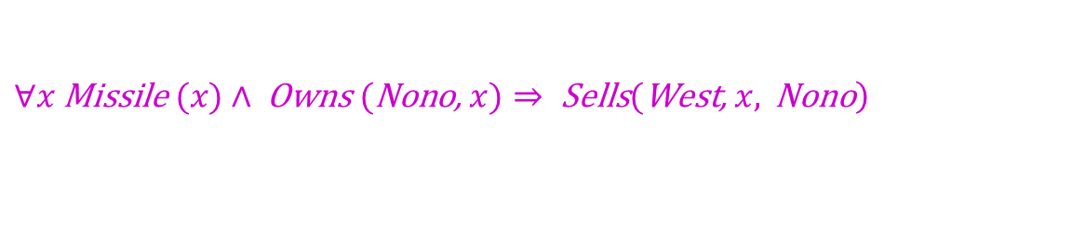
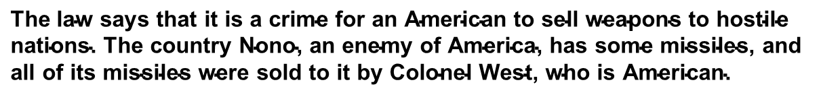
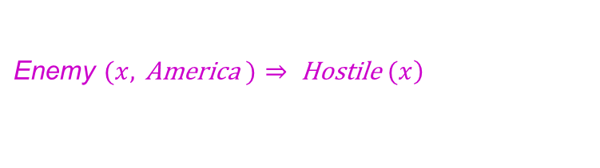

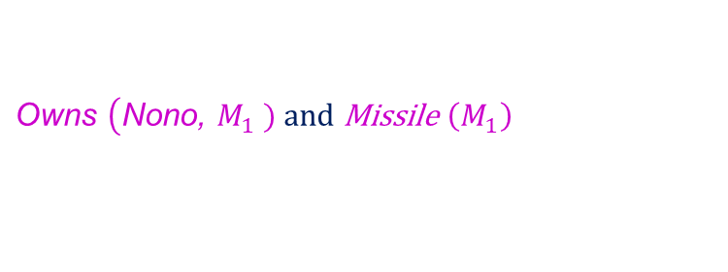
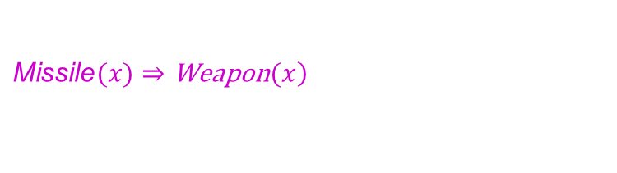
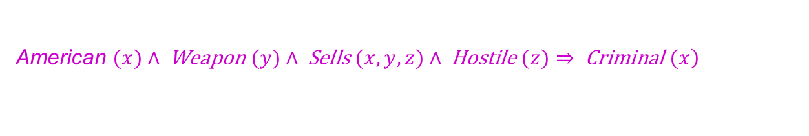

Example knowledge base
$$\text{The} \text{law} \text{says} \text{that} \text{it} \text{is} \text{a} \text{crime} \text{for} \text{an} \text{American} \text{to} \text{sell} \text{weapons} \text{to} \text{hostile} \text{nations}\text{. }\text{The} \text{country} \text{Nono}\text{, }\text{an} \text{enemy} \text{of} \text{America}\text{, }\text{has} \text{some} \text{missiles}\text{, }\text{and} \text{all} \text{of} \text{its} \text{missiles} \text{were} \text{sold} \text{to} \text{it} \text{by} \text{Colonel} \text{West}\text{, }\text{who} \text{is} \text{American}\text{.}$$
Prove that Col. West is a criminal
… it is a crime for an American to sell weapons to hostile nations:
$$\left. \text{American} (x)∧ \text{Weapon} (y)∧ \text{Sells} (x,y,z)∧ \text{Hostile} (z)⇒ \text{Criminal} (x\right)$$
$$\text{Nono} … \text{has} \text{some} \text{missiles}\text{, }\text{i}\text{.}\text{e}\text{., }∃x \text{Owns} (\text{Nono}\text{, }x)∧\text{Missile}(\text{x})\text{ : }$$
$$\text{Owns} \left(\text{Nono}\text{, }M_{1}\right. \text{) }\text{and} \text{Missile} \left(M_{1}\right)$$
$$\text{...} \text{all} \text{of} \text{its} \text{missiles} \text{were} \text{sold} \text{to} \text{it} \text{by} \text{Colonel} \text{West}$$
$$\left.∀x \text{Missile} (x)∧ \text{Owns} (\text{Nono}\text{, }x)⇒ \text{Sells}(\text{West}\text{, }x, \text{Nono}\right)$$
$$\text{Missiles} \text{are} \text{weapons}\text{: }$$
$$\left.\text{Missile}(x)⇒\text{Weapon}(x\right)$$
$$\text{An} \text{enemy} \text{of} \text{America} \text{counts} \text{as}\text{ "}\text{hostile}\text{"}:$$
$$\left.\text{Enemy} (x, \text{America} )⇒ \text{Hostile} (x\right)$$
$$\text{West}\text{, }\text{who} \text{is} \text{American} ...$$
$$\left.\text{American}(\text{West}\right)$$
$$\text{The} \text{country} \text{Nono}\text{, }\text{an} \text{enemy} \text{of} \text{America} …$$
$$\text{Enemy}\text{ (}\text{Nono}\text{, }\text{America}\text{) }$$

Slide 17
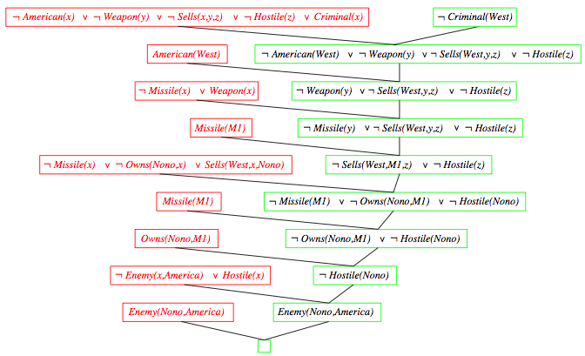
Resolution proof

Slide 18
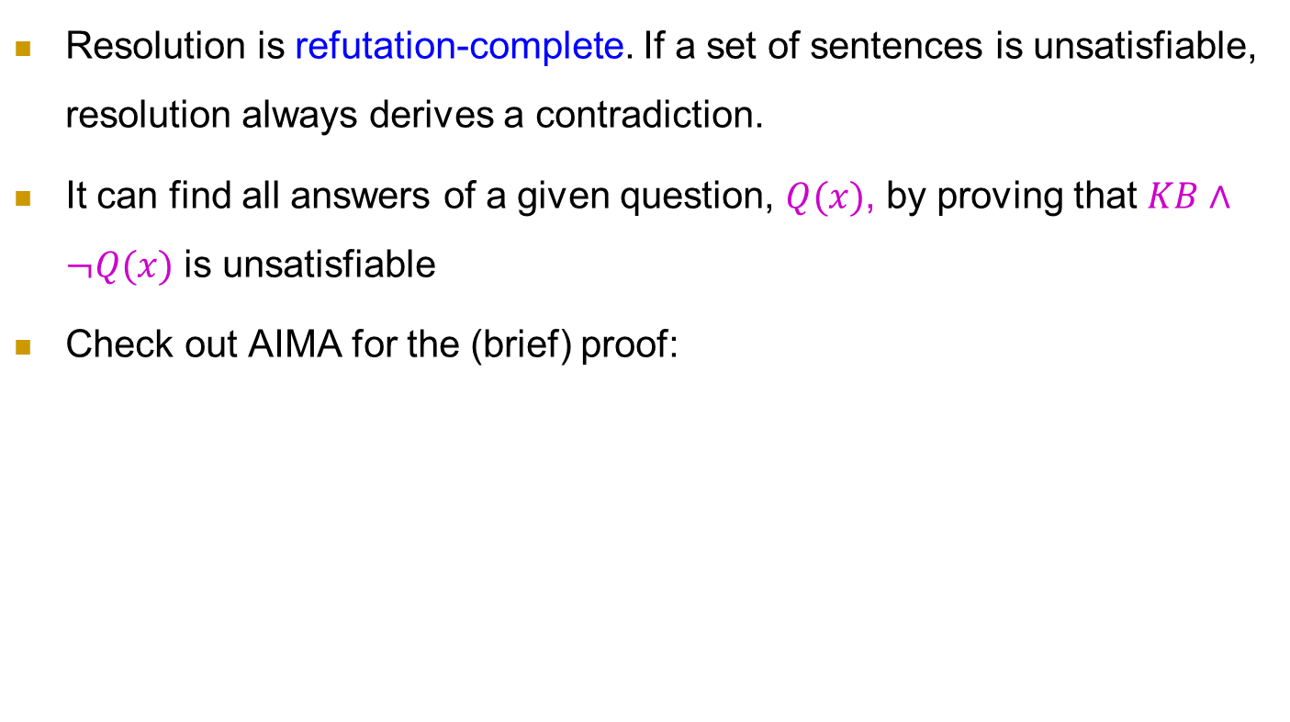
Completeness of FOL resolution
Resolution is refutation-complete. If a set of sentences is unsatisfiable, resolution always derives a contradiction.
It can find all answers of a given question, $Q(x)$, by proving that $KB∧¬Q(x)$ is unsatisfiable
Check out AIMA for the (brief) proof:
If S is an unsatisfiable set of clauses, then the application of a finite number of resolution steps to S will yield a contradiction

Slide 19
First-Order Logic: Inference
Generalized Modus Ponens

Slide 20
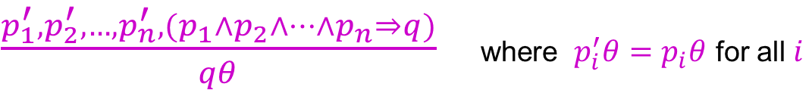
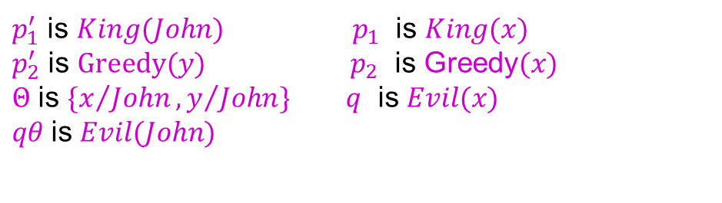
Generalized Modus Ponens (GMP) 前见推理
$\frac{p_{1}^{′},p_{2}^{′},…,p_{n}^{′}, (p_{1}∧p_{2}∧…∧p_{n}⇒q)}{qθ}$ where $p_{i}^{′}θ=p_{i}θ$ for all $i$
$p_{1}^{′}$ is $King(John)$ $p_{1}$ is $King(x)$
$p_{2}^{′}$ is $Greedy(y)$ $p_{2}$ is Greedy$(x)$
$Θ$ is $\{x/{John},y/{John}\}$ $q$ is $Evil(x)$
$qθ$is $Evil(John)$
GMP used with KB of definite clauses (exactly one positive literal) All variables assumed universally quantified

Slide 21
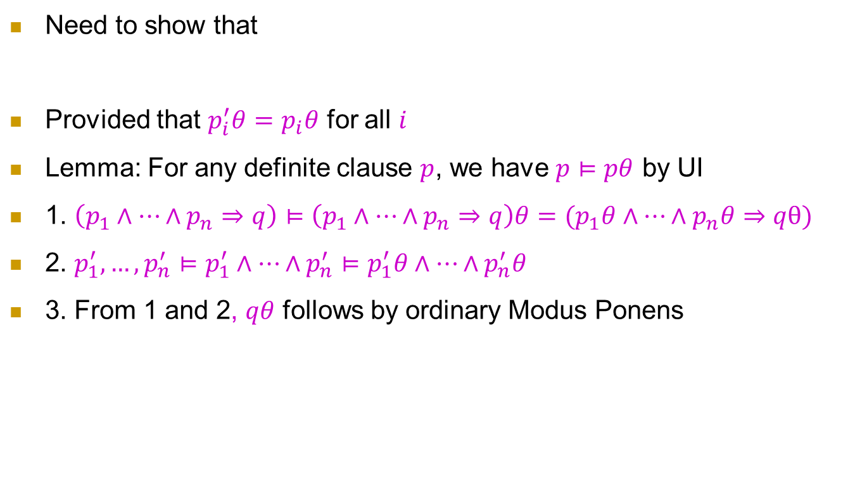
Soundness of GMP
Need to show that
Provided that $p_{i}^{′}θ=p_{i}θ$ for all $i$
Lemma: For any definite clause $p$, we have $p⊨pθ$ by UI
1. $\left(p_{1}∧…∧p_{n}⇒q\right)⊨\left(p_{1}∧…∧p_{n}⇒q\right)θ=(p_{1}θ∧…∧p_{n}θ⇒qθ)$
2. $p_{1}^{′},…,p_{n}^{′}⊨p_{1}^{′}∧…∧p_{n}^{′}⊨p_{1}^{′}θ∧…∧p_{n}^{′}θ$
3. From 1 and 2, $qθ$ follows by ordinary Modus Ponens
$$p_{1}^{′},…,p_{n}^{′}, \left(p_{1}∧…∧p_{n}⇒q\right)⊨qθ$$
the soundness of ordinary Modus Ponens

Slide 22
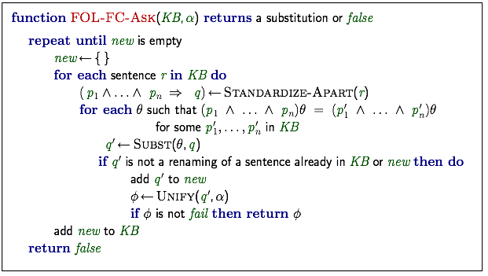
Forward chaining algorithm

Slide 23









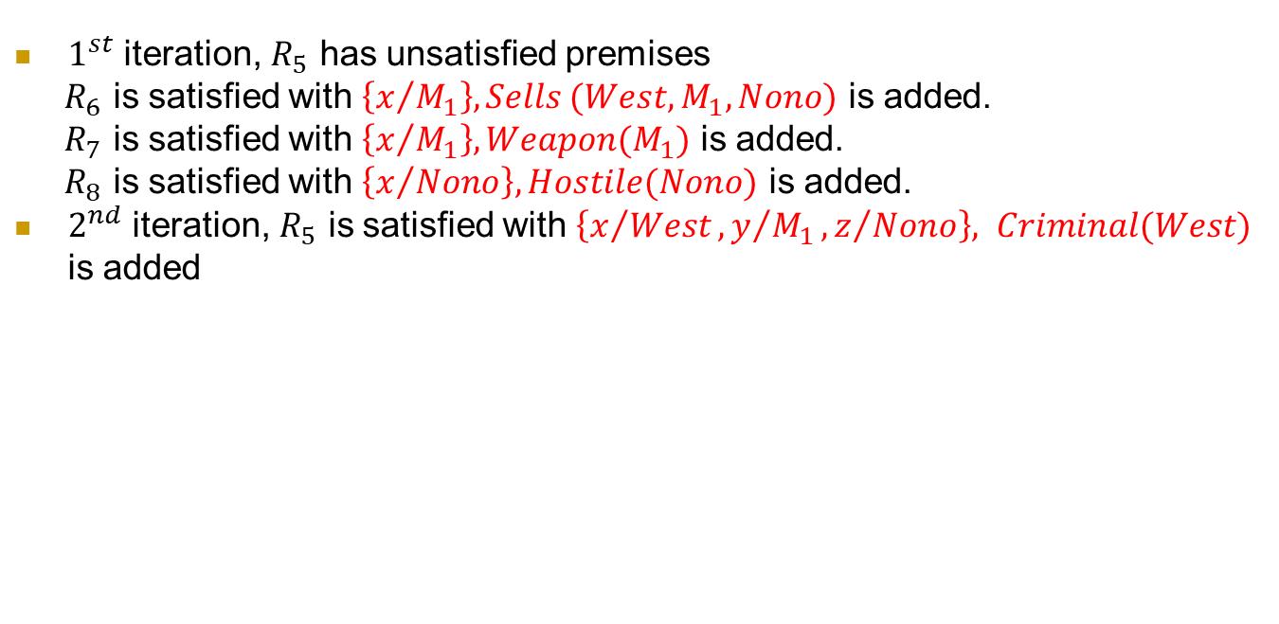






Forward chaining proof
Implications
Facts
$R_{5}$
$$American\left(x\right)∧Weapon\left(y\right)∧Sells\left(x,y,z\right)∧Hostile(z)⇒Criminal(x)$$
$R_{1}$
$\text{Owns}\text{(}\text{Nono}\text{, }M_{1}$)
$R_{2}$
$$\text{Missile} \left(M_{1}\right)$$
$R_{6}$
$$Missile(x)∧Owns(Nono,x)⇒Sells(West,x,Nono)$$
$R_{3}$
$$American(West)$$
$R_{4}$
$$Enemy(Nono,America)$$
$R_{7}$
$$Missile(x)⇒Weapon(x)$$
$R_{8}$
$$Enemy(x,America)⇒Hostile(x)$$
$1^{st}$ iteration, $R_{5}$ has unsatisfied premises
$R_{6}$ is satisfied with $\left\{x/{M_{1}}\right\}, Sells (West, M_{1},Nono)$ is added.
$R_{7}$ is satisfied with $\left\{x/{M_{1}}\right\}, Weapon(M_{1})$ is added.
$R_{8}$ is satisfied with $\left\{x/{Nono}\right\}, Hostile(Nono)$ is added.
$2^{nd}$ iteration, $R_{5}$ is satisfied with $\left\{x/{West},y/{M_{1}},z/{Nono}\right\}, Criminal(West)$ is added

Slide 24
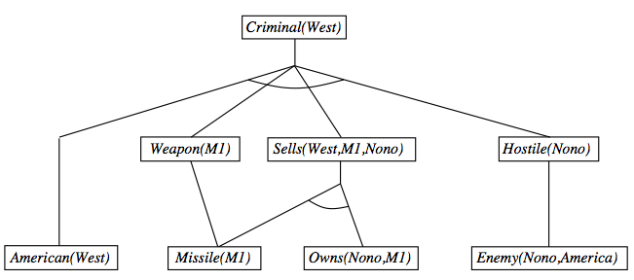
Forward chaining proof

Slide 25
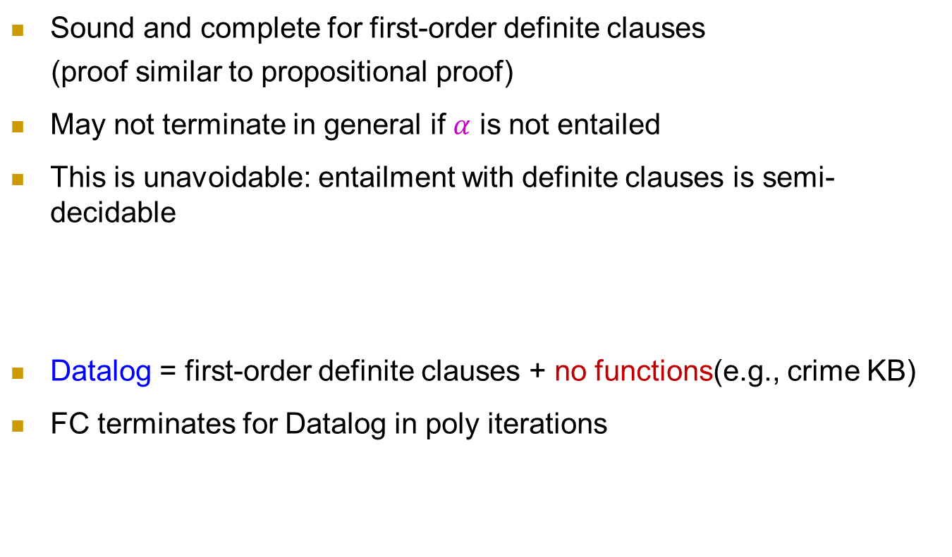
Properties of forward chaining
Sound and complete for first-order definite clauses
(proof similar to propositional proof)
May not terminate in general if $α$ is not entailed
This is unavoidable: entailment with definite clauses is semi-decidable
Datalog = first-order definite clauses + no functions(e.g., crime KB)
FC terminates for Datalog in poly iterations

Slide 26
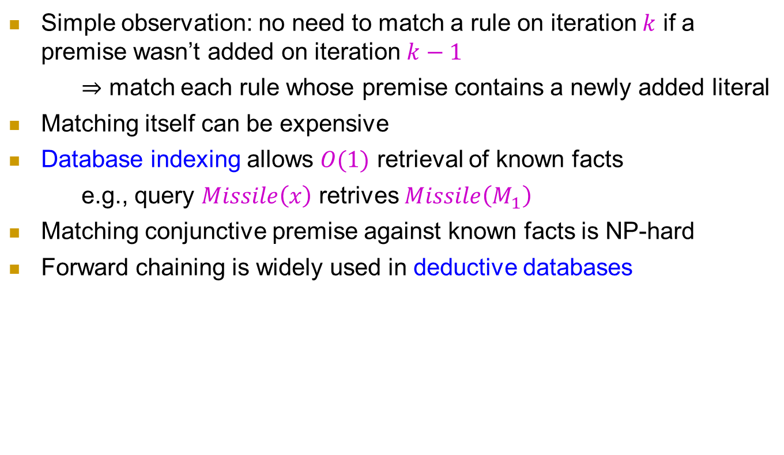
Efficiency of forward chaining
Simple observation: no need to match a rule on iteration $k$ if a premise wasn’t added on iteration $k−1$
$⇒$ match each rule whose premise contains a newly added literal
Matching itself can be expensive
Database indexing allows $O(1)$ retrieval of known facts
e.g., query $Missile\left(x\right)$ retrives $Missile\left(M_{1}\right)$
Matching conjunctive premise against known facts is NP-hard
Forward chaining is widely used in deductive databases

Slide 27
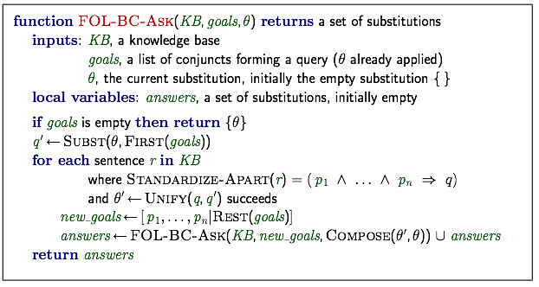
Backward chaining algorithm

Slide 28
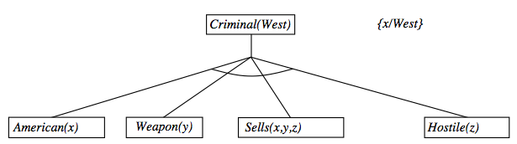
Backward chaining example

Slide 29
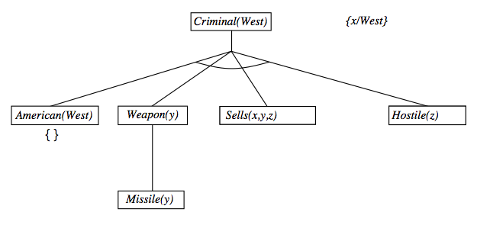
Backward chaining example

Slide 30
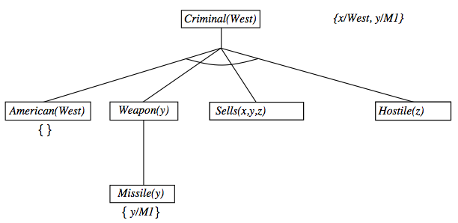
Backward chaining example

Slide 31
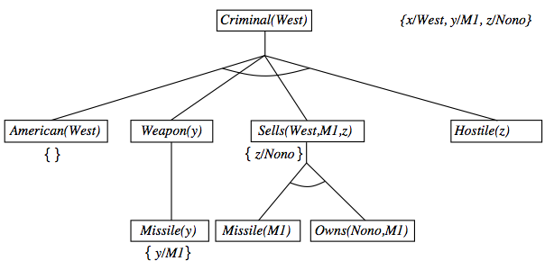
Backward chaining example

Slide 32
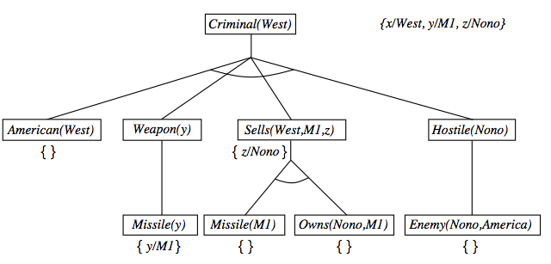
Backward chaining example

Slide 33
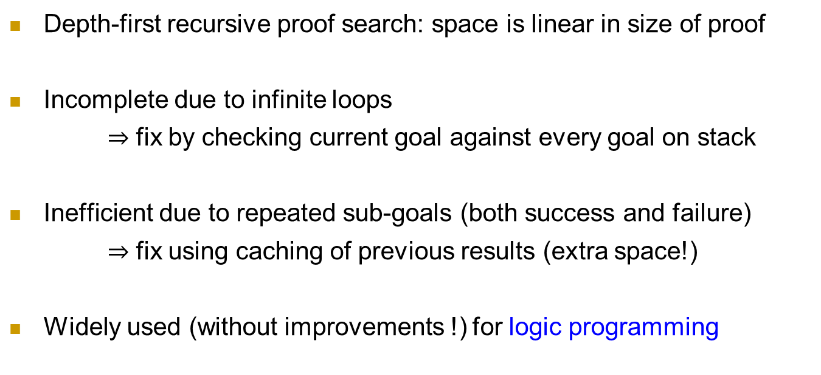
Properties of backward chaining
AND-OR search: AND for all premises; OR since the goal query can be proved by any rules
Depth-first recursive proof search: space is linear in size of proof
Incomplete due to infinite loops
$⇒$ fix by checking current goal against every goal on stack
Inefficient due to repeated sub-goals (both success and failure)
$⇒$ fix using caching of previous results (extra space!)
Widely used (without improvements !) for logic programming

Slide 34
Logic Programming: Prolog

Slide 35
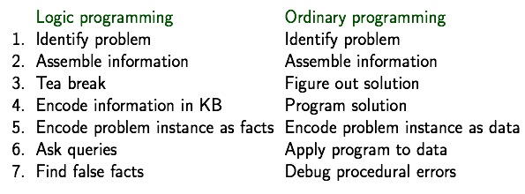

Logic programming
Sound bite: computation as inference on logical KBs
Should be easier to debug $Capital\left(NewYork,US\right)$ than $x≔x+2$

Slide 36
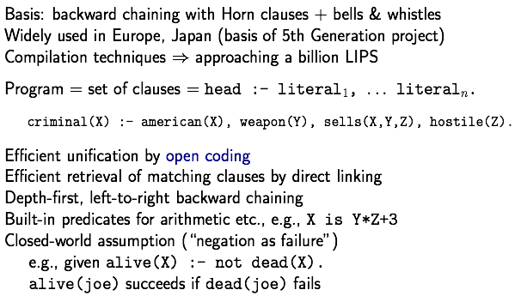
Prolog systems

Slide 37
Prolog examples
Depth-first search from a start state X:
dfs(X) :— goal(x).
dfs(X) :— successor(X,S),dfs(S).
No need to loop over S: successor succeeds for each
Appending two lists to produce a third:
append({}, Y, Y).
append( [X|L], Y, [X|Z]) :— append(L, Y, Z).
Query: append(A, B, [1:2]) ?
Answers: A=[] B=[1, 2]
A=[1] B=[2]
A=[1, 2] B=[]
第二个input放到第一个的右边

Slide 38
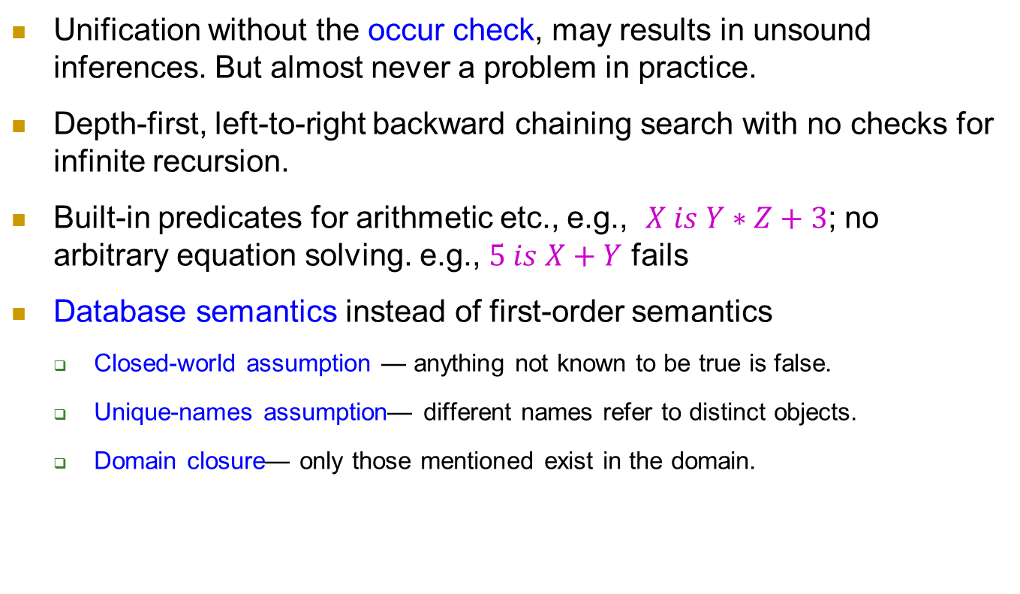
Prolog systems
Unification without the occur check, may results in unsound inferences. But almost never a problem in practice.
Depth-first, left-to-right backward chaining search with no checks for infinite recursion.
Built-in predicates for arithmetic etc., e.g., $X is Y∗Z+3$; no arbitrary equation solving. e.g., $5 is X+Y$ fails
Database semantics instead of first-order semantics
Closed-world assumption — anything not known to be true is false.
Unique-names assumption— different names refer to distinct objects.
Domain closure— only those mentioned exist in the domain.

Slide 39
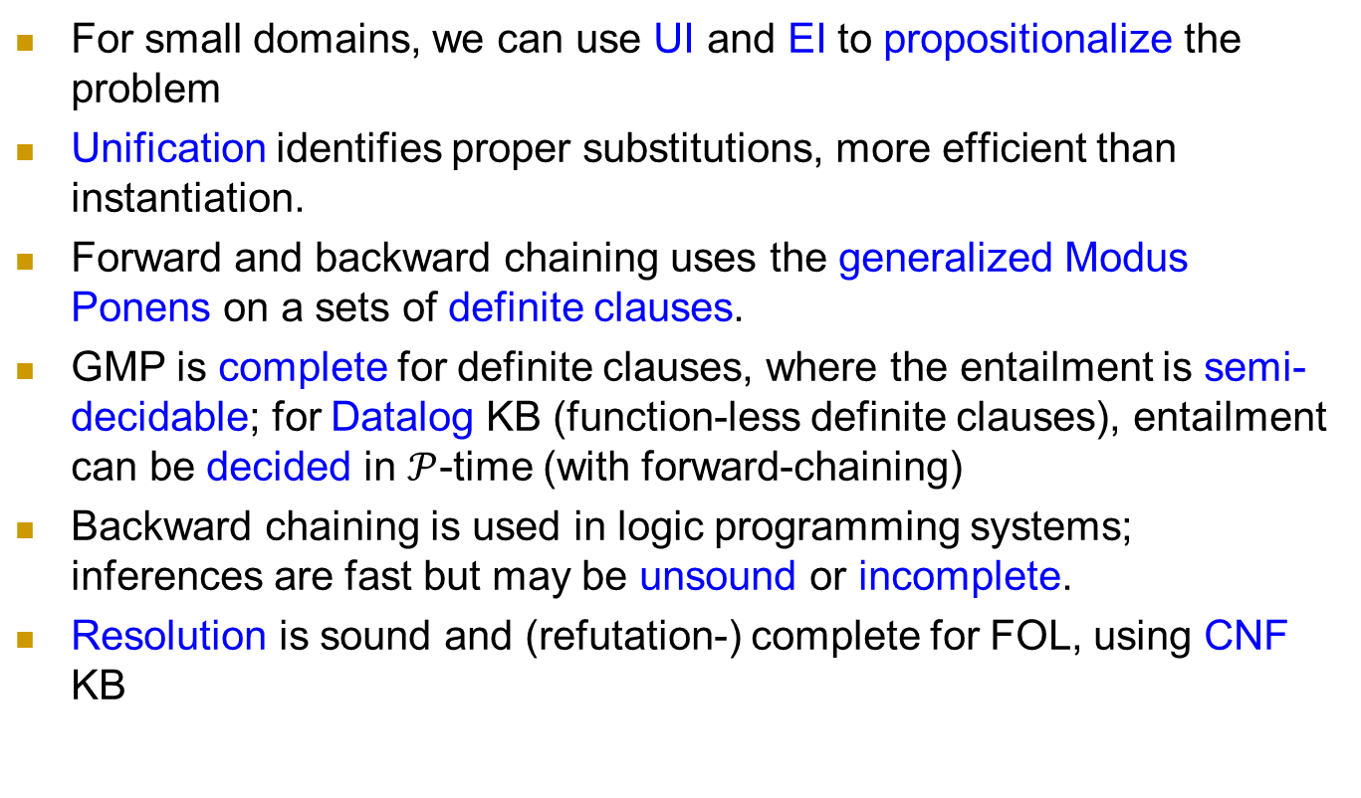
Summary
For small domains, we can use UI and EI to propositionalize the problem
Unification identifies proper substitutions, more efficient than instantiation.
Forward and backward chaining uses the generalized Modus Ponens on a sets of definite clauses.
GMP is complete for definite clauses, where the entailment is semi-decidable; for Datalog KB (function-less definite clauses), entailment can be decided in $𝒫$-time (with forward-chaining)
Backward chaining is used in logic programming systems; inferences are fast but may be unsound or incomplete.
Resolution is sound and (refutation-) complete for FOL, using CNF KB

Slide 40
Homework
member(1,[1,2,3,4,5])
member(3,[1,2,3,4,5]) 要求：给出一个集合，列出其所有元素
subset([2,4],[1,2,3,4,5]) 要求：给出一个集合，列出其所有子集

Slide 41
Homework
事实的集合：有三种事实
is_relation (fact_ID, company_name, time, index-name, value)
supplier (fact_ID, time, company_A, company_B, k, value)
client (fact_ID, time, company_A, company_B, k, value)
检测冲突的事实（facts）
给定一个事实的集合，找出所有“冲突”的fact ID对
思考：什么情形“发生冲突”

